Slide 1

Type with a swipe: A gesture keyboard
Project review

Slide 2
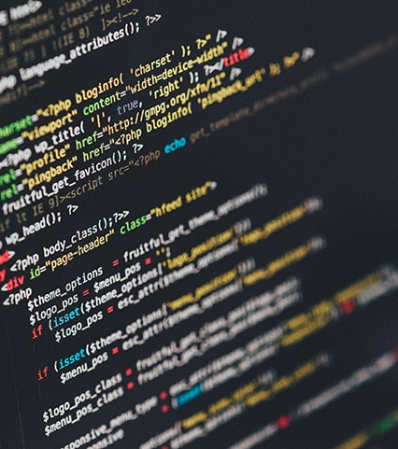
INTRODUCTION
A brief insight

Slide 3
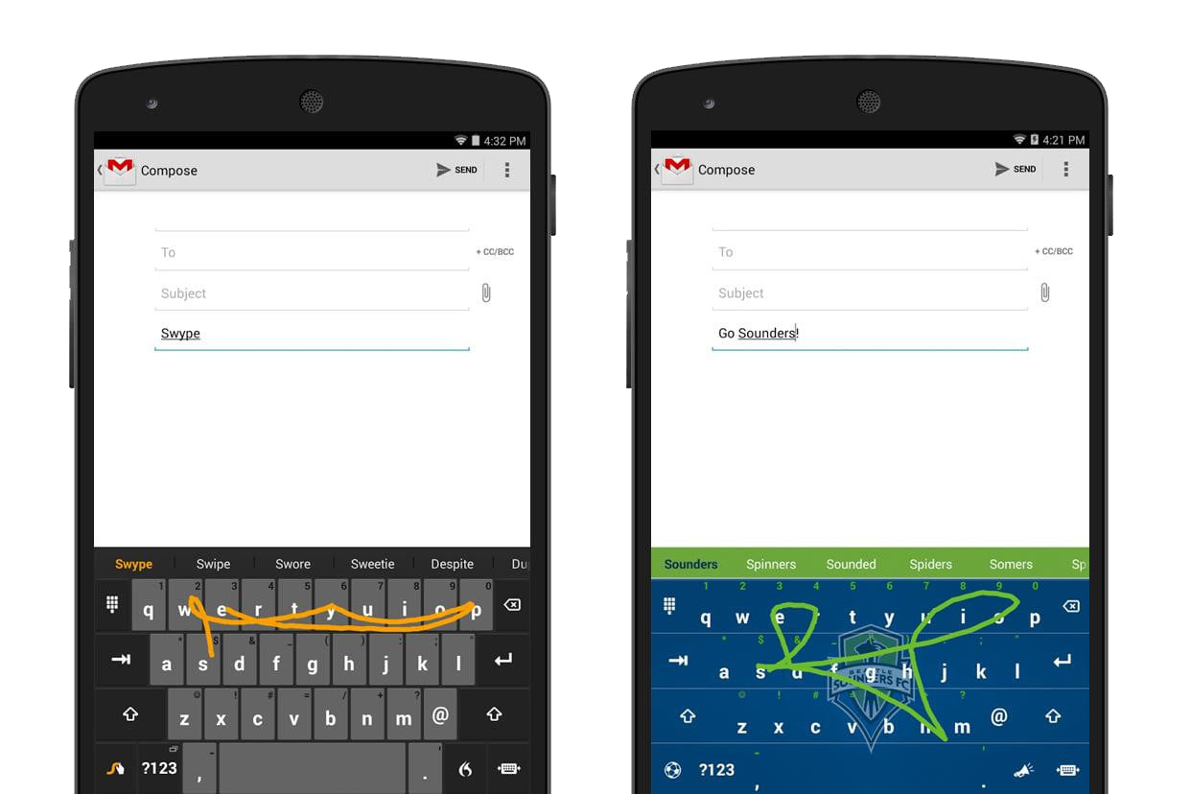
Swipe typing
The go-to virtual input method?
Gesture keyboards allow users to enter text using continuous input strokes.
They are also known as gesture typing or shape writing or swipe typing.
The user enters words by sliding a finger or stylus from the first letter of a word to its last letter, lifting only between words.
It generally uses error-correction algorithms and a language model to guess the intended word.
It mainly has two major components that contribute to its accuracy and speed: an input path analyzer, and word search engine with corresponding database.

Slide 4

Abstract
Quick Overview
This project is made for the J-Component of Human Computer Interaction course, the main objective of doing this project is to implement a program for real-life problems with HCI and understand its working.
The aim of our project is to understand through research and implementation, the workings of gesture typing. Swipe typing is a stroke-based text input technique for cell phones. Rather than tapping, the client enters a word by gesturing through the entirety of its letters on a virtual keyboard with a single persistent stroke. Despite the fact that swipe typing is a broadly accessible input method for touch devices, there's very limited known about the concepts behind it. This work fills this hole by setting up a physiological development model for swipe typing. Several existing approaches are assessed and using that a simple program is implemented to see the project in action.
More details about the project will be further discussed in the presentation.

Slide 5


Problem Description
Human Computer interaction has become an inseparable important aspect in all technological segments, and input methods are one of the important components.
In the market dominated by touch-enabled devices, it’s matter of high priority that people are enable to give their input in an easy and fast manner.
A gesture keyboard can be viewed as a conventional touch keyboard that also affords gestures.
Drawing or doodling is a fun and easy action that even children enjoy doing. A gesture is in some sense a more appropriate action than serial tapping on a conventional keyboard.
The user does not have to have learned any gestures before using a word-gesture keyboard. As a beginner, the user simply slides the finger from one letter to another, driven by visual guidance to the next letter key on the keyboard.

Slide 6
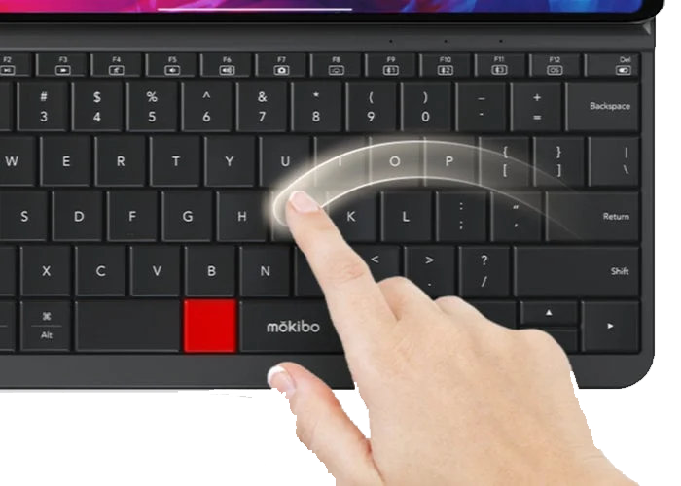
THE approach
SHARK stands for SHorthand Aided Rapid Keyboarding.
SHARK2 is successor of original SHARK algorithm which enabled gesturing on a stylus keyboard for familiar words but required tapping for others.
The algorithm is designed for Stylus-Keyboards (SK) also knows as virtual keyboards.
SHARK2 algorithm eliminates the need to switch between these 2 modes and allow swipe typing for almost all words.
Each pattern of a word is formed by the trajectory through all of the letters of the word on the virtual keyboard, from the first to the last in order.
These patterns are called sokgraph (SK + Graph).

Slide 7

SHArk2 algorithm
The optimal approach?
The number of sokgraph (slide patterns) gestures each individual user may need is much greater than the gesture repertoire of an alphanumeric recognizer such as Graffiti or Jot.
Unlike natural (longhand) cursive handwriting recognition, a fraction of the sokgraph shorthand gestures, particularly those for short words, can be identical or similar in shape; therefore shape alone may not provide sufficient information to recognize the user’s intent.
A set of sokgraphs defined on a keyboard layout constitutes a symbolic system novel to the user.
It is an advantage because each sokgraph has a unique ideal prototype, in contrast to natural hand writing in which even the same letter can be written in perfectly legitimate but very different styles.
It is also a disadvantage because there is not a natural corpus of sokgraphs that can be collected, precluding many of the standard data-driven machine learning approaches to recognition

Slide 8

System Requirements
What it takes?
Every instance of word entry, except adding new words to the lexicon by tapping, has to be realized by sokgraph recognition. To the system there is no distinction between visually guided tracing and recall-based gesturing. The recognition system has to be able to recognize all words an individual user may use in regular writing. The size of the lexicon should be in the order of 10,000 words.
The system has to be extensible to new words a user may adopt in writing.
The system has to be “real time”. The recognition latency can only be a small fraction of the entire duration of writing a word.
The system should be compatible with the SHARK2 paradigm, supporting gradual transition from visually guided tracing to recall driven gesturing.
The system should give the user the maximum amount of flexibility and least amount ambiguity.

Slide 9

The algorithm
Let’s dive in!

Slide 10
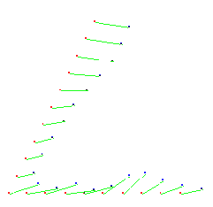
Template pruning
Shape channel recognition
The proportional shape matching distance between an unknown pattern u and a template pattern t is used for classification of sokgraph.
The final result of the shape channel is an approximate scale and translation invariant distance measure of the similarity between the patterns.
It is based on the average sum of the equidistant sample points’ spatial distance.
An initial pruning component first filters out a large number of the sokgraph templates from entering later stage recognition channels.
We compute the start-to-start and end-to-end distances between a sokgraph template and the normalized unknown input gesture.
If either of the two distances is greater than a set threshold, the template will be discarded.
PROPORTIONAL MATCHING OF TWO POINTS

Slide 11
Location recognition
Dynamic channel weighting
Location information provides an increased recognition resolution of sokgraphs.
Location is part of the user’s memory of a sokgraph and therefore will be reproduced during gesture production.
The sokgraph shape recognition produces several sokgraph confusion and location plays an important role to distinguish among the lexicon.
We use a function that gives the lowest weight to the middle point, and the rest of the points’ weights increase linearly towards the two ends.
Adjusting the relative weight of the shape and location channels according to the speed of the input gesture production gives more versatility and accuracy to the model.
If user tracks sokgraph from word to word, the location channel will yield high score.
If user rapidly swipes in loop between start and end letters, shape channel will yield high score.
The dynamic weighting is primarily based on the gesturing speed.
It modifies the location channel probability of each individual word according to its path on the keyboard.

Slide 12

Existing methods
How it’s been done in the past?

Slide 13

Paper-1: Burgbacher, U., & Hinrichs, K. (2016). Synthetic Word Gesture Generation for Stroke-Based Virtual Keyboards. IEEE transactions on human-machine systems, 47(2), 221-234.
Paper-2: Simon, L., Xu, W., & Anderson, R. (2016). Don’t interrupt me while I type: Inferring text entered through gesture typing on Android keyboards. Proceedings on Privacy Enhancing Technologies, 2016(3), 136-154.
Paper-3: Zhai, S., & Kristensson, P. O. (2012). The word-gesture keyboard: reimagining keyboard interaction. Communications of the ACM, 55(9), 91-101.
Paper-4: Kristensson, P. O., & Zhai, S. (2004, October). SHARK2: a large vocabulary shorthand writing system for pen-based computers. In Proceedings of the 17th annual ACM symposium on User interface software and technology (pp. 43-52).
Paper-5: Gordon, M., Ouyang, T., & Zhai, S. (2016, May). WatchWriter: Tap and gesture typing on a smartwatch miniature keyboard with statistical decoding. In Proceedings of the 2016 CHI Conference on Human Factors in Computing Systems (pp. 3817-3821).
Paper-6: Smith, B. A., Bi, X., & Zhai, S. (2015, April). Optimizing touchscreen keyboards for gesture typing. In Proceedings of the 33rd Annual ACM Conference on Human Factors in Computing Systems (pp. 3365-3374).
Paper-7: Reyal, S., Zhai, S., & Kristensson, P. O. (2015, April). Performance and user experience of touchscreen and gesture keyboards in a lab setting and in the wild. In Proceedings of the 33rd Annual ACM Conference on Human Factors in Computing Systems (pp. 679-688).

Slide 14
Research Journal | Title (Study) | Year of Publication | Problem Addressed
Paper - 1 | Synthetic Word Gesture Generation for Stroke-Based Virtual Keyboards | 2017 | Introduce a framework capable of synthesizing the trajectories of word gestures that share many features with human-generated gestures. We use these synthetic gestures to automatically evaluate gesture recognition algorithms with thousands of gestures.
Paper - 2 | Inferring Text Entered Through Gesture Typing on Android Keyboards | 2016 | A new way in which systemwide resources can be a threat to user privacy. We investigate the effect of rate limiting as a countermeasure but find that determining a proper rate is error-prone and fails in subtle cases. We conclude that real-time interrupt information should be made inaccessible, perhaps via a tighter SELinux policy in the next Android version.
Paper - 3 | The Word-Gesture Keyboard: Reimagining Keyboard Interaction | 2012 | This article summarizes a decade-long academic research that led to the establishment of this input paradigm. We developed the basic concepts and initial prototype of a word-gesture keyboard
Paper - 4 | SHARK2: A Large Vocabulary Shorthand Writing System for Pen-based Computers | 2014 | Based on the use characteristics and human performance observations, we designed and implemented the architecture, algorithms and interfaces of a high-capacity multi-channel pen-gesture recognition system.
Paper - 5 | Tap and Gesture Typing on a Smartwatch Miniature Keyboard with Statistical Decoding | 2016 | A finger operated keyboard that supports both touch and gesture typing with statistical decoding on a smartwatch. Just like on modern smartphones, users type one letter per tap or one word per gesture stroke on WatchWriter but in a much smaller spatial scale.
Paper – 6 | Optimizing Touchscreen Keyboards for Gesture Typing | 2015 | This paper systematically investigates the optimization space related to the accuracy, speed, and Qwerty similarity of a gesture typing keyboard. Our investigation shows that optimizing the layout for gesture clarity (a metric measuring how unique word gestures are on a keyboard) drastically improves the accuracy of gesture typing.
Paper - 7 | Performance and User Experience of Touchscreen and Gesture Keyboards in a Lab Setting and in the Wild | 2015 | study the performance and user experience of two popular mainstream mobile text entry methods: the Smart Touch Keyboard (STK) and the Smart Gesture Keyboard (SGK).

Slide 15

Proposed work
How we’re going to do it!

Slide 16

# The proposed approach
The proposed work will be using a python based virtual keyboard for the implementation of SHARK2 algorithm to demonstrate swipe typing.
The keyboard is hosted as a web application using the Flask module in python.
The Application is programmed to have all the necessary functions for the identification of sokgraph and mapping the pattern to N-best choices from the dataset.
The “Words_10000” dataset is used for the model.
The dataset is derived by using n-gram frequency analysis on Google’s word corpus to extract most common 10000 words in English language according to their frequency.

Slide 17

tools used
PYTHON
Flask
SciPy
NumPy
Dataset used
Words_10000

Slide 18
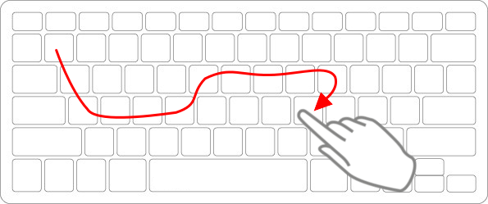
The dataset is extracted into 4 arrays: Words, probability, X and Y template points respectively. The template points correspond to the alphabets’ co-ordinates in the virtual keyboard.
The backed processing of sokgraph is done and matched again the derived arrays to ger N-best words.
generate_sample_points():
Converts every gesture to a set of 100 points for comparison of input sokgraph and template.
Returns 2 arrays of sampled points for both X and Y co-ordinates.
NumPy functions are used to calculate distance among the consecutive elements of the template.
Sample points are generated for every template in the dataset in prior.
Interpolation is used to generate middle points using SciPy.
do_pruning():
Compares the length of the corresponding word from the dictionary. If the length is less than or equal to 4, then it only compares the start to start and end to end distances of the template point with a certain threshold value.
If the length is greater than 4, it also considers some intermediate points among the sampled ones for comparison so as to exclude unnecessary words after pruning.
WORKFLOW

Slide 19
get_shape_scores():
The total number of words in the pruned list is pretty less as compared to original list which helps in speeding up the code.
The function generates shape score for every valid words after pruning.
The sampled input gesture is compared against valid template and assigned a score for each comparison.
The computed scores are normalized and stored in an array.
get_location_scores():
The location scores are also computed through comparison against valid sampled inputs.
The distance of trace input from template is calculated using hypot function from NumPy.
The template trace lines are defined by connecting the centroids of the alphabets constituting the word.
Both input and template trace are re-sampled to N-points.
get_integration_scores():
The contribution of shape and location scores is managed by defining the score coefficients.
The balance between the scores is managed and then the normalized contribution of each score is summed up to give final integration score.
The final scores are stored in an array for all the possible valid words.
WORKFLOW

Slide 20
WORKFLOW
get_best_word():
Using NumPy we find the sorted index of the integration scores.
The index is matched with valid words array and the word is returned as the best match for the recorded sokgraph.
Further, next 3 matching words from the sorted index are also returned as suggestion.
The app is designed on Flask framework to run on web and the interactive virtual keyboard is hosted to a browser.
The implementation result is attached in further slide.

Slide 21
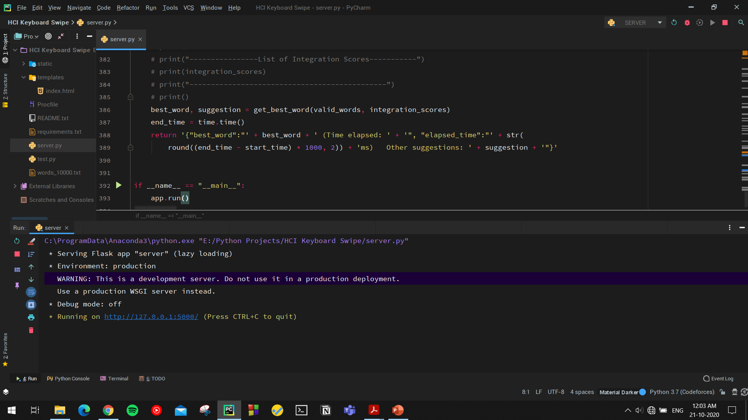
Code execution

Slide 22
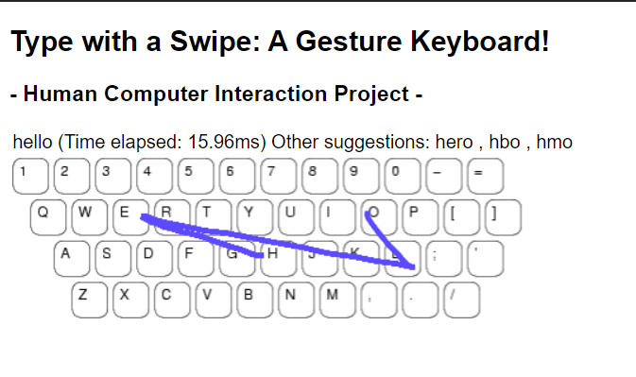
Final implementation

Slide 23

https://www.extremetech.com/extreme/97837-how-does-swype-really-work#:~:text=The%20cornerstone%20of%20the%20Swype,be%20achieved%20with%20minimal%20practice.
https://www.thenationalnews.com/arts-culture/what-is-gesture-typing-the-time-saving-texting-technique-we-might-soon-all-be-using-1.874986#:~:text=To%20achieve%20this%2C%20Basit%20us,lifting%20only%20between%20each%20word.
https://www.shuminzhai.com/post/a-guided-tour-of-my-recent-papers-on-keyboard-research
https://en.wikipedia.org/wiki/Virtual_keyboard
http://uist.acm.org/archive/adjunct/2004/pdf/doctoral_consortium/dc3-kristensson.pdf
https://en.wikipedia.org/wiki/Swype
REFERENCES

Slide 24


THANK YOU
SHAURYA CHOUDHARY (18BCE2113)

